Slide 1
CH3 Factor model

Slide 2
Agenda
Arbitrage Pricing Theorem
The Covariance Matrix
Application: Calculating the risk on a portfolio
Application: Calculating portfolio beta
Application: Tracking basket design
Sensitivity Analysis
Summary

Slide 3
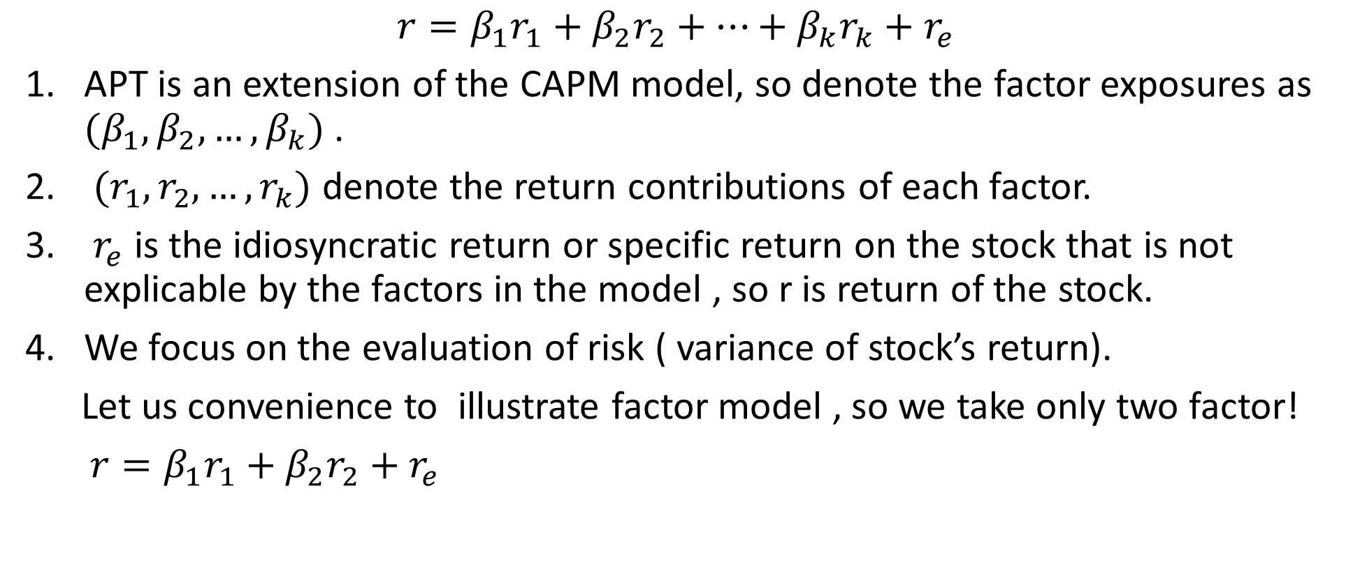
Arbitrage Pricing Theorem
$$r=β_{1}r_{1}+β_{2}r_{2}+…+β_{k}r_{k}+r_{e}$$
APT is an extension of the CAPM model, so denote the factor exposures as ${(β}_{1},β_{2},…,β_{k})$ .
$(r_{1},r_{2},…,r_{k})$ denote the return contributions of each factor.
$r_{e}$ is the idiosyncratic return or specific return on the stock that is not explicable by the factors in the model , so r is return of the stock.
We focus on the evaluation of risk ( variance of stock’s return).
Let us convenience to illustrate factor model , so we take only two factor!
$r=β_{1}r_{1}+β_{2}r_{2}+r_{e}$

Slide 4
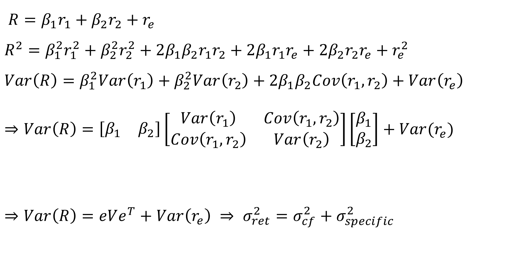
Arbitrage Pricing Theorem
$R=β_{1}r_{1}+β_{2}r_{2}+r_{e}$
$$R^{2}=β_{1}^{2}r_{1}^{2}+β_{2}^{2}r_{2}^{2}+2β_{1}β_{2}r_{1}r_{2}+2β_{1}r_{1}r_{e}+2β_{2}r_{2}r_{e}+r_{e}^{2}$$
$$Var\left(R\right)=β_{1}^{2}Var\left(r_{1}\right)+β_{2}^{2}Var\left(r_{2}\right)+2β_{1}β_{2}Cov\left(r_{1},r_{2}\right)+Var\left(r_{e}\right)$$
$$⇒Var\left(R\right)=\left[\begin{matrix}β_{1} & β_{2}\end{matrix}\right]\left[\begin{matrix}Var\left(r_{1}\right) & Cov\left(r_{1},r_{2}\right) \\ Cov\left(r_{1},r_{2}\right) & Var\left(r_{2}\right)\end{matrix}\right]\left[\begin{matrix}β_{1} \\ β_{2}\end{matrix}\right]+Var(r_{e})$$
$⇒Var\left(R\right)=eVe^{T}+Var\left(r_{e}\right) ⇒ σ_{ret}^{2}=σ_{cf}^{2}+σ_{specific}^{2}$
The factor exposure vector denote “e”
Covariance matrix denote “V”

Slide 5
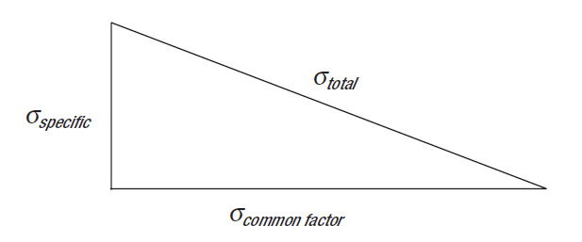
Arbitrage Pricing Theorem
It turns out that the specific variance is the smaller component of the total variance, and a significant portion of the total variance is explained by the common factor variance.
Note that key to the evaluation of the common factor variance is the knowledge of the covariance matrix of factor returns.
How do we get a sample of past historic factor returns?

Slide 6
Arbitrage Pricing Theorem
Factor Exposure Matrix :
This is the matrix of exposure/sensitivity factors. If there are N stocks in
our universe and k factors in the model, we can construct a N × k matrix
with the exposures for each stock in a row.Let us denote this matrix as X.
Factor Covariance Matrix :
This is denoted as V.
Specific Variance Matrix :
This is the specific variance for each of the N stocks assembled in an N × N
matrix with the specific variances on the diagonal. Because the specific
variances are assumed to be uncorrelated , the non-diagonal elements are
zero. This matrix is denoted as Δ.

Slide 7
The Covariance Matrix
The covariance matrix :
A key role in the determination of the risk.
A square matrix.
In a model with k factors, the dimensions of the covariance matrix is k × k.
The diagonal elements form the variance of the individual factors, and the non-diagonal elements are the covariances and may have nonzero values.
The returns of two explanatory factors share some correlation.

Slide 8
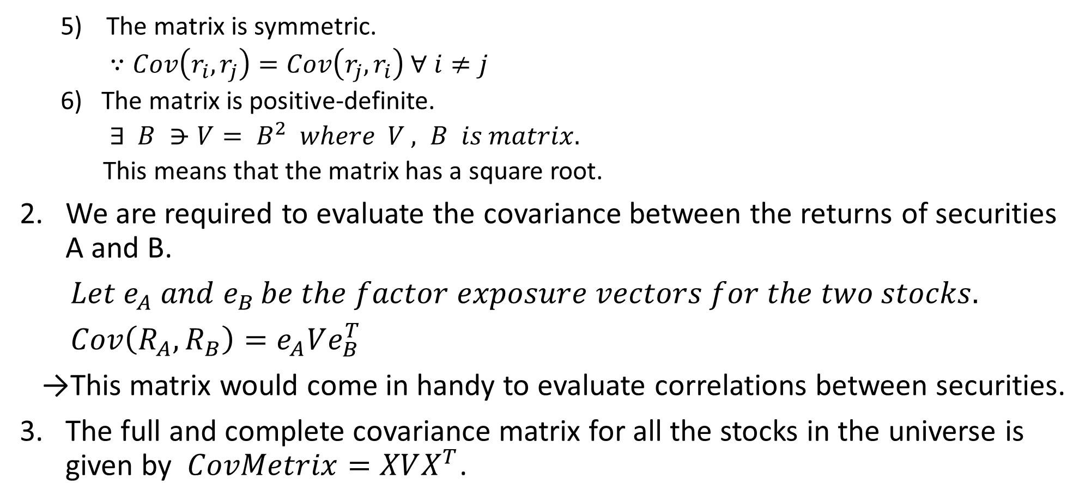
The Covariance Matrix
The matrix is symmetric.
$∵Cov\left(r_{i},r_{j}\right)=Cov\left(r_{j},r_{i}\right) ∀ i≠j$
The matrix is positive-definite.
$∃ B ⋺V= B^{2} where V , B is matrix.$
This means that the matrix has a square root.
We are required to evaluate the covariance between the returns of securities A and B.
$Let e_{A} and e_{B }be the factor exposure vectors for the two stocks.$
$Cov\left(R_{A},R_{B}\right)=e_{A}Ve_{B}^{T}$
→This matrix would come in handy to evaluate correlations between securities.
The full and complete covariance matrix for all the stocks in the universe is given by $CovMetrix=XVX^{T}$.

Slide 9
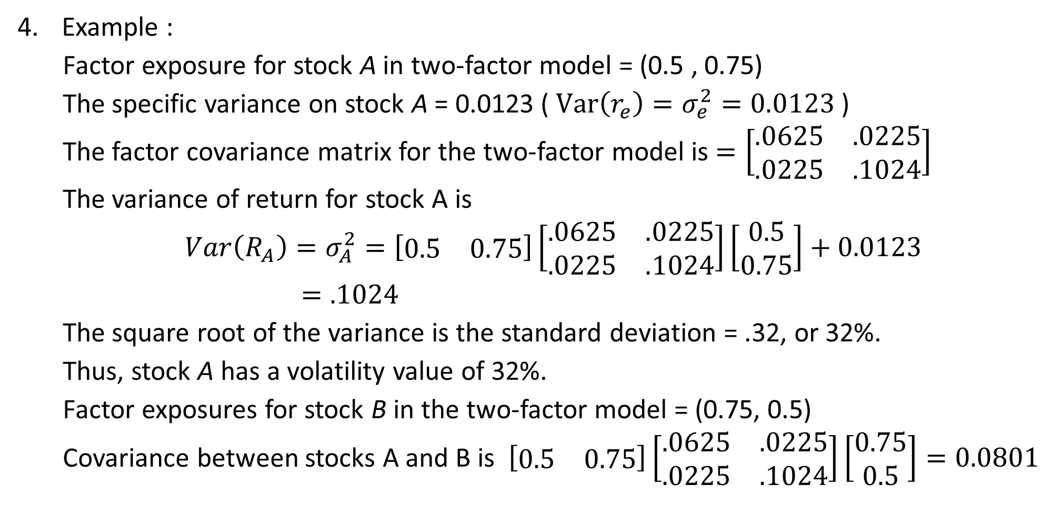
The Covariance Matrix
Example :
Factor exposure for stock A in two-factor model = (0.5 , 0.75)
The specific variance on stock A = 0.0123 ( $Var\left(r_{e}\right)=σ_{e}^{2}=0.0123$ )
The factor covariance matrix for the two-factor model is $=\left[\begin{matrix}.0625 & .0225 \\ .0225 & .1024\end{matrix}\right]$
The variance of return for stock A is
$Var\left(R_{A}\right)=σ_{A}^{2}=\left[\begin{matrix}0.5 & 0.75\end{matrix}\right]\left[\begin{matrix}.0625 & .0225 \\ .0225 & .1024\end{matrix}\right]\left[\begin{matrix}0.5 \\ 0.75\end{matrix}\right]+0.0123$
$=.1024$
The square root of the variance is the standard deviation = .32, or 32%.
Thus, stock A has a volatility value of 32%.
Factor exposures for stock B in the two-factor model = (0.75, 0.5)
Covariance between stocks A and B is $\left[\begin{matrix}0.5 & 0.75\end{matrix}\right]\left[\begin{matrix}.0625 & .0225 \\ .0225 & .1024\end{matrix}\right]\left[\begin{matrix}0.75 \\ 0.5\end{matrix}\right]=0.0801$

Slide 10
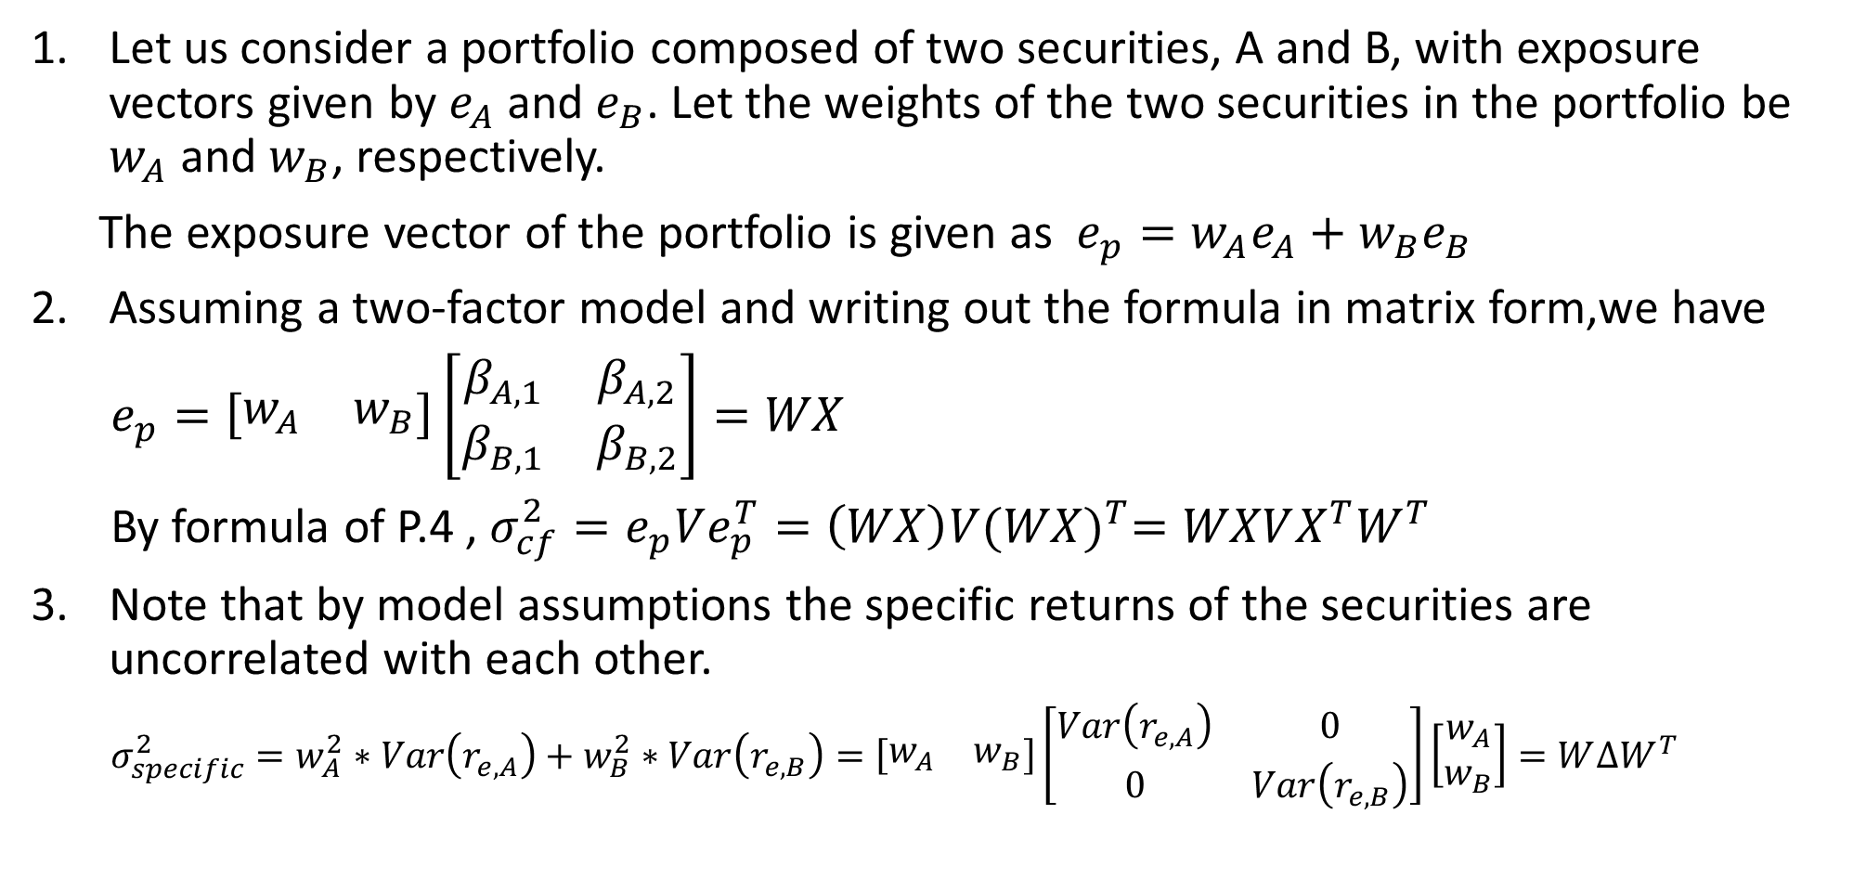
Application: Calculating the risk on a portfolio
Let us consider a portfolio composed of two securities, A and B, with exposure vectors given by $e_{A}$ and $e_{B}$. Let the weights of the two securities in the portfolio be $w_{A}$ and $w_{B}$, respectively.
The exposure vector of the portfolio is given as $e_{p}=w_{A}e_{A}+w_{B}e_{B}$
Assuming a two-factor model and writing out the formula in matrix form,we have
$e_{p}=\left[\begin{matrix}w_{A} & w_{B}\end{matrix}\right]\left[\begin{matrix}β_{A,1} & β_{A,2} \\ β_{B,1} & β_{B,2}\end{matrix}\right]=WX$
By formula of P.4 , $σ_{cf}^{2}=e_{p}Ve_{p}^{T}=\left(WX\right)V{(WX)}^{T}=WXVX^{T}W^{T}$
Note that by model assumptions the specific returns of the securities are uncorrelated with each other.
$σ_{specific}^{2}=w_{A}^{2}∗Var\left(r_{e,A}\right)+w_{B}^{2}∗Var\left(r_{e,B}\right)=\left[\begin{matrix}w_{A} & w_{B}\end{matrix}\right]\left[\begin{matrix}Var\left(r_{e,A}\right) & 0 \\ 0 & Var\left(r_{e,B}\right)\end{matrix}\right]\left[\begin{matrix}w_{A} \\ w_{B}\end{matrix}\right]=W∆W^{T}$

Slide 11
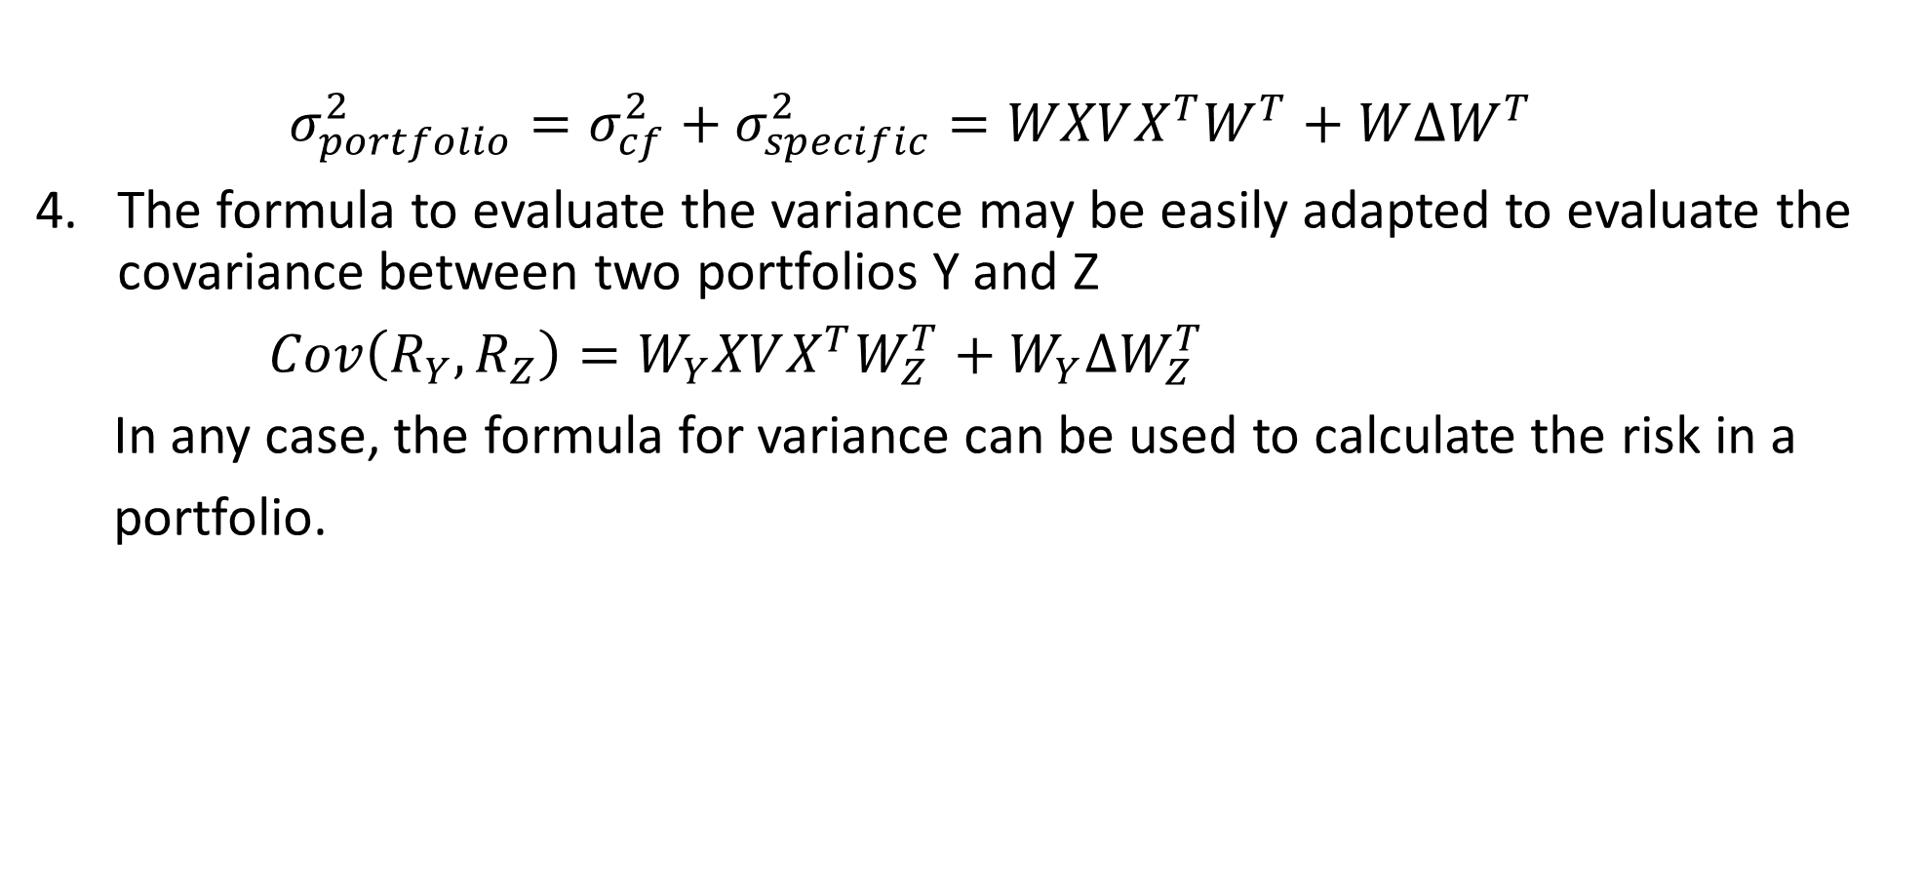
Application: Calculating the risk on a portfolio
$σ_{portfolio}^{2}=σ_{cf}^{2}+σ_{specific}^{2}=WXVX^{T}W^{T}+W∆W^{T}$
The formula to evaluate the variance may be easily adapted to evaluate the covariance between two portfolios Y and Z
$Cov\left(R_{Y},R_{Z}\right)=W_{Y}XVX^{T}W_{Z}^{T}+W_{Y}∆W_{Z}^{T}$
In any case, the formula for variance can be used to calculate the risk in a
portfolio.

Slide 12
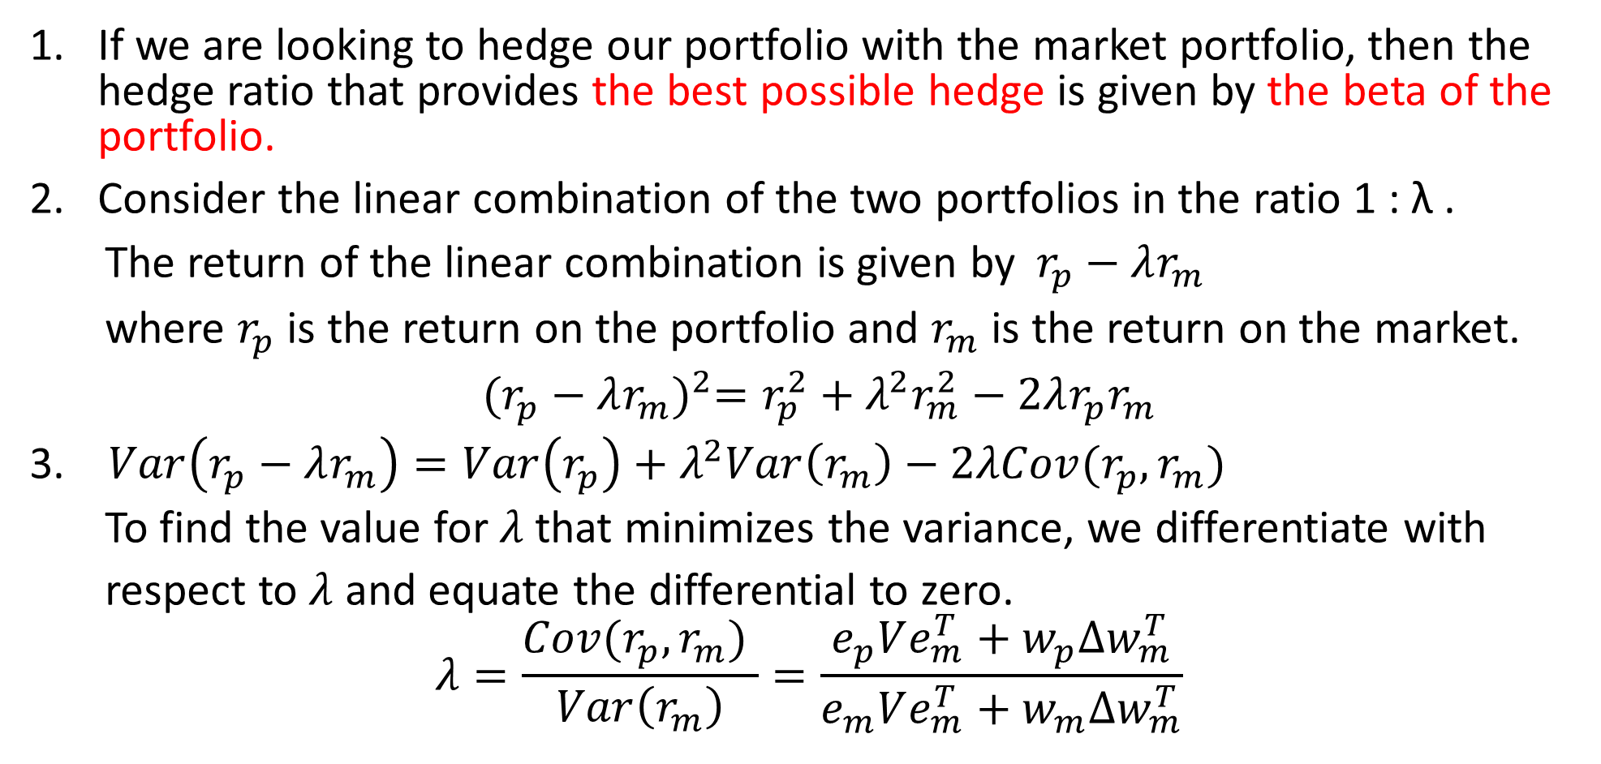
Application: Calculating portfolio beta
If we are looking to hedge our portfolio with the market portfolio, then the hedge ratio that provides the best possible hedge is given by the beta of the portfolio.
Consider the linear combination of the two portfolios in the ratio 1 : λ .
The return of the linear combination is given by$r_{p}−λr_{m}$
where $r_{p}$ is the return on the portfolio and $r_{m}$ is the return on the market.
${(r_{p}−λr_{m})}^{2}=r_{p}^{2}+λ^{2}r_{m}^{2}−2λr_{p}r_{m}$
$Var\left(r_{p}−λr_{m}\right)=Var\left(r_{p}\right)+λ^{2}Var\left(r_{m}\right)−2λCov(r_{p},r_{m})$
To find the value for $λ$ that minimizes the variance, we differentiate with
respect to $λ$ and equate the differential to zero.
$$λ=\frac{Cov(r_{p},r_{m}) }{Var\left(r_{m}\right)}=\frac{e_{p}Ve_{m}^{T}+w_{p}∆w_{m}^{T}}{e_{m}Ve_{m}^{T}+w_{m}∆w_{m}^{T}}$$
APT framework

Slide 13
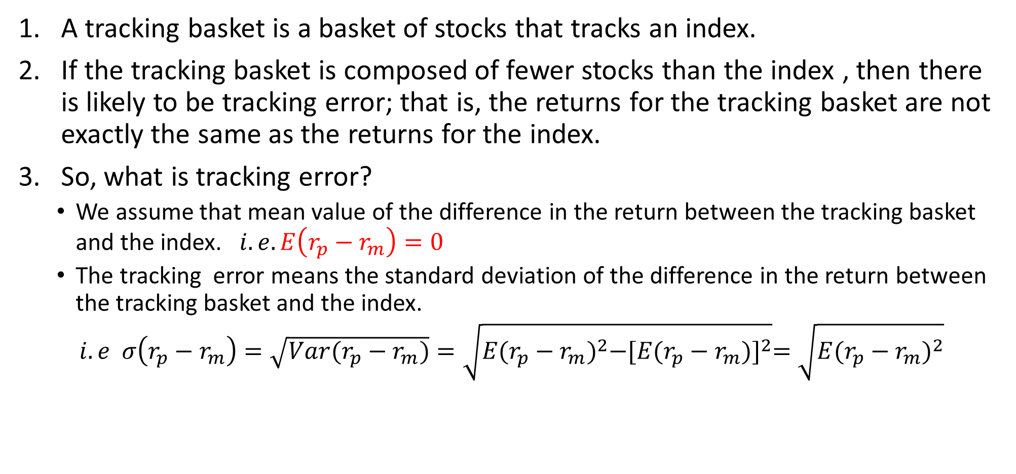
Application: Tracking basket design
A tracking basket is a basket of stocks that tracks an index.
If the tracking basket is composed of fewer stocks than the index , then there is likely to be tracking error; that is, the returns for the tracking basket are not exactly the same as the returns for the index.
So, what is tracking error?
We assume that mean value of the difference in the return between the tracking basket and the index. $i.e. E\left(r_{p}−r_{m}\right)=0$
The tracking error means the standard deviation of the difference in the return between the tracking basket and the index.
$i.e σ\left(r_{p}−r_{m}\right)=\sqrt{Var(r_{p}−r_{m})}=\sqrt{E{(r_{p}−r_{m})}^{2}−{[E(r_{p}−r_{m})]}^{2}}=\sqrt{E{(r_{p}−r_{m})}^{2}}$

Slide 14
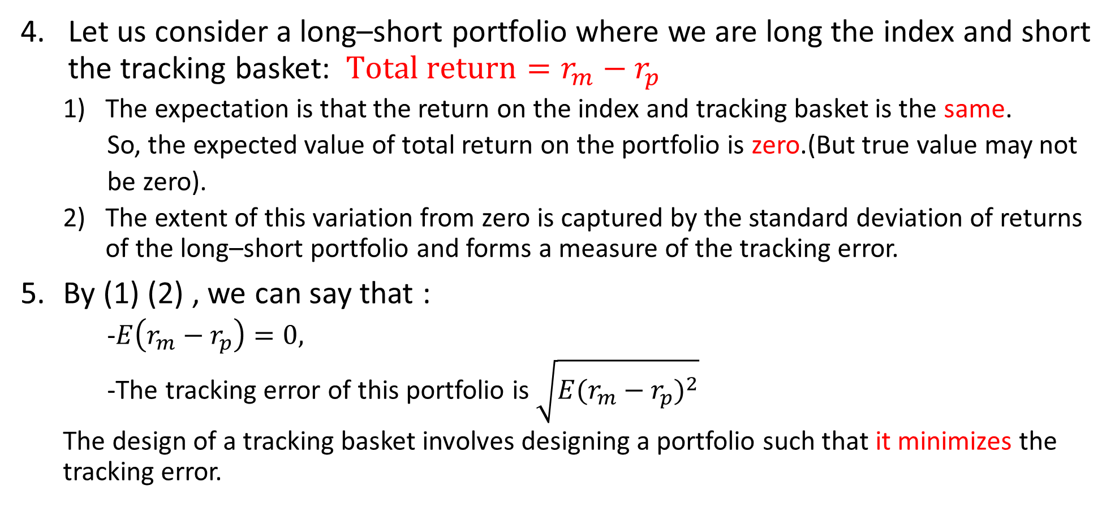
Application: Tracking basket design
Let us consider a long–short portfolio where we are long the index and short the tracking basket: $Total return=r_{m}−r_{p}$
The expectation is that the return on the index and tracking basket is the same.
So, the expected value of total return on the portfolio is zero.(But true value may not
be zero).
The extent of this variation from zero is captured by the standard deviation of returns of the long–short portfolio and forms a measure of the tracking error.
By (1) (2) , we can say that :
-$E\left(r_{m}−r_{p}\right)=0,$
-The tracking error of this portfolio is $\sqrt{E{(r_{m}−r_{p})}^{2}}$
The design of a tracking basket involves designing a portfolio such that it minimizes the tracking error.

Slide 15
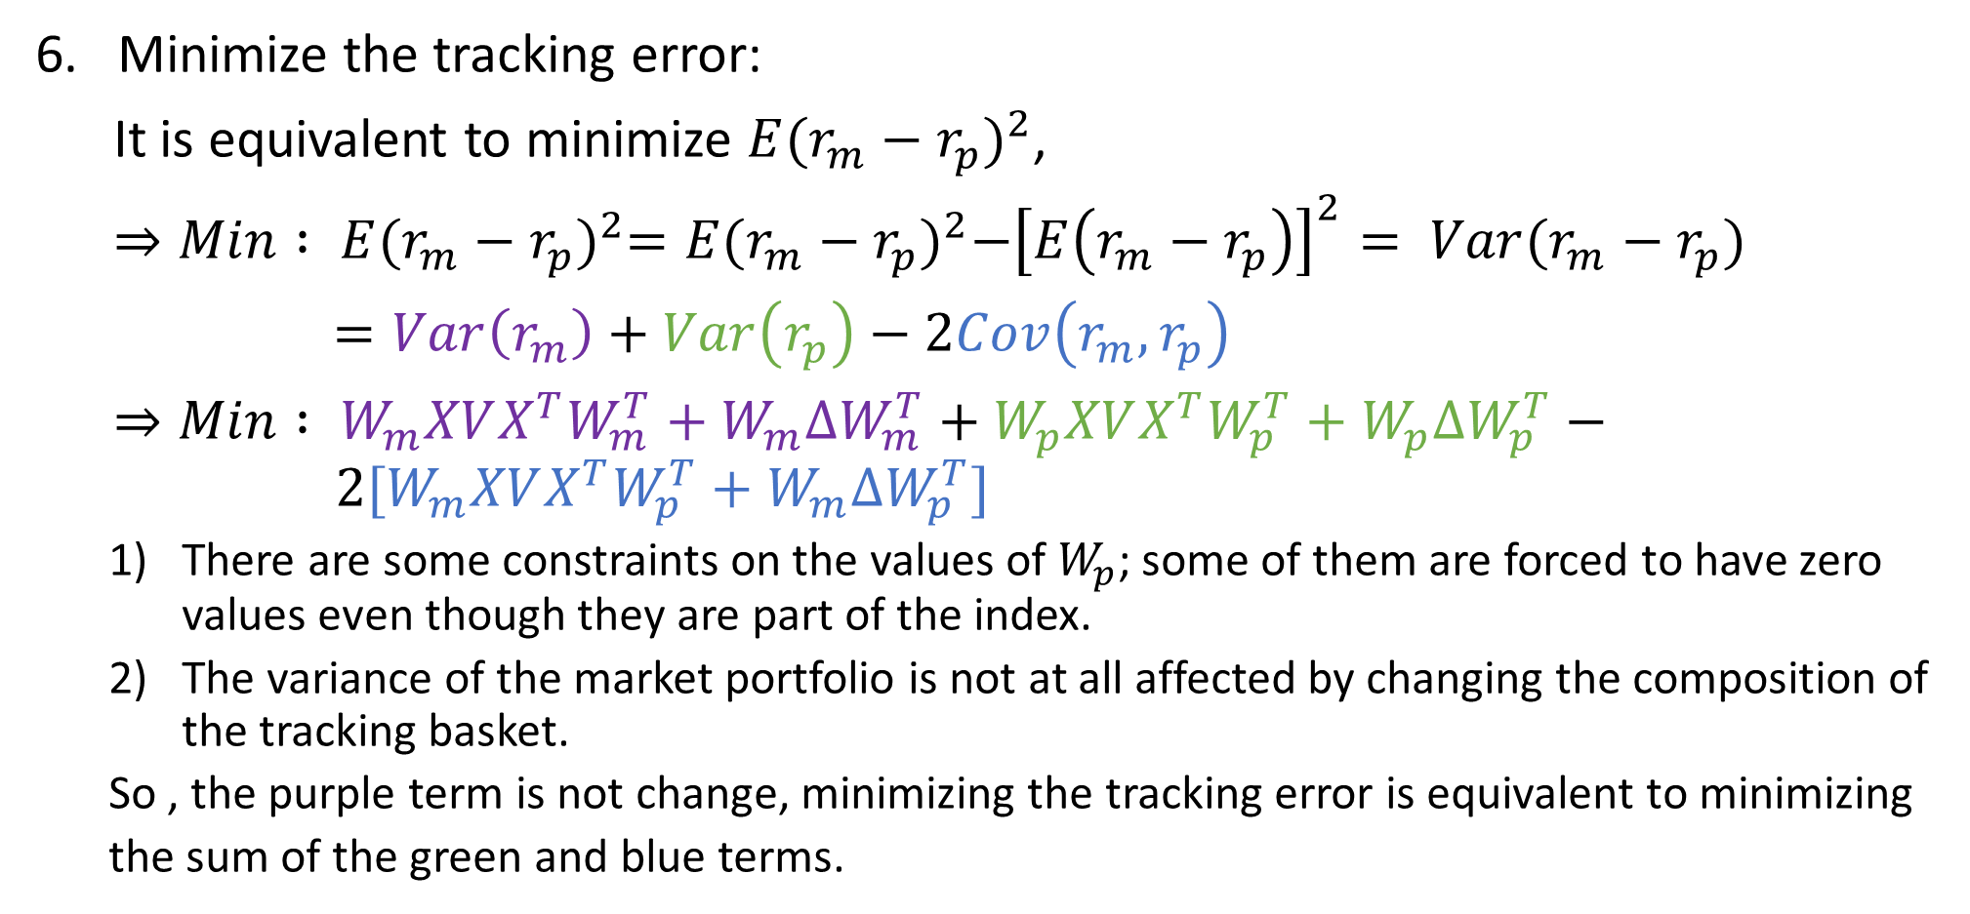
Application: Tracking basket design
Minimize the tracking error:
It is equivalent to minimize $E{(r_{m}−r_{p})}^{2}$,
$⇒Min : E{(r_{m}−r_{p})}^{2}=E{(r_{m}−r_{p})}^{2}−{\left[E\left(r_{m}−r_{p}\right)\right]}^{2}= Var(r_{m}−r_{p})$
$=Var\left(r_{m}\right)+Var\left(r_{p}\right)−2Cov\left(r_{m},r_{p}\right)$
$⇒Min : W_{m}XVX^{T}W_{m}^{T}+W_{m}∆W_{m}^{T}+W_{p}XVX^{T}W_{p}^{T}+W_{p}∆W_{p}^{T}− 2[W_{m}XVX^{T}W_{p}^{T}+W_{m}∆W_{p}^{T}]$
There are some constraints on the values of $W_{p}$; some of them are forced to have zero values even though they are part of the index.
The variance of the market portfolio is not at all affected by changing the composition of the tracking basket.
So , the purple term is not change, minimizing the tracking error is equivalent to minimizing
the sum of the green and blue terms.

Slide 16

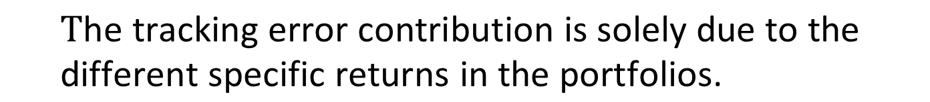
Application: Tracking basket design
The error variance may also be viewed as a sum of a common factor component and a specific component.
$σ_{error}^{2}=σ_{cf}^{2}+σ_{specific}^{2}$
$σ_{error}^{2}= 0 +σ_{specific}^{2}$ ,
$σ_{specific}^{2}$ very small ∵$σ_{cf}^{2}≫σ_{specific}^{2}$
Tracking basket ‘s factor match the factor of the index
The two portfolios are highly diversified ,$E\left(r_{specific}\right)=0$
$$\text{T}\text{he} \text{tracking} \text{error} \text{contribution} \text{is} \text{solely} \text{due} \text{to} \text{the} \text{different} \text{specific} \text{returns} \text{in} \text{the} \text{portfolios}\text{.}$$

Slide 17
Sensitivity Analysis

